Slide 1
Change Seminar
October 14 2010

Slide 2
Change Discussions
One discussion topic each week
Three presenters
Each presenter discusses one project and prepares discussion questions
Choose your own project or I can provide suggestions

Slide 3
Discussion Scheduling
10/28: Education
  Presenters:
11/11: Microfinance
  Presenters:
11/25: Communication
  Presenters:
12/9: Health
  Presenters:

Slide 4
Applications of imaging in ICTD
October 14 2010

Slide 5
Today’s discussion
Cell Scope – Mobile microscopy for disease diagnosis (Berkeley)
A system for non-contact, automated cardiac pulse measurements using video imaging and blind source separation (MIT)
A system for automated spectroscopy using cell phone cameras (University of Illinois)

Slide 6
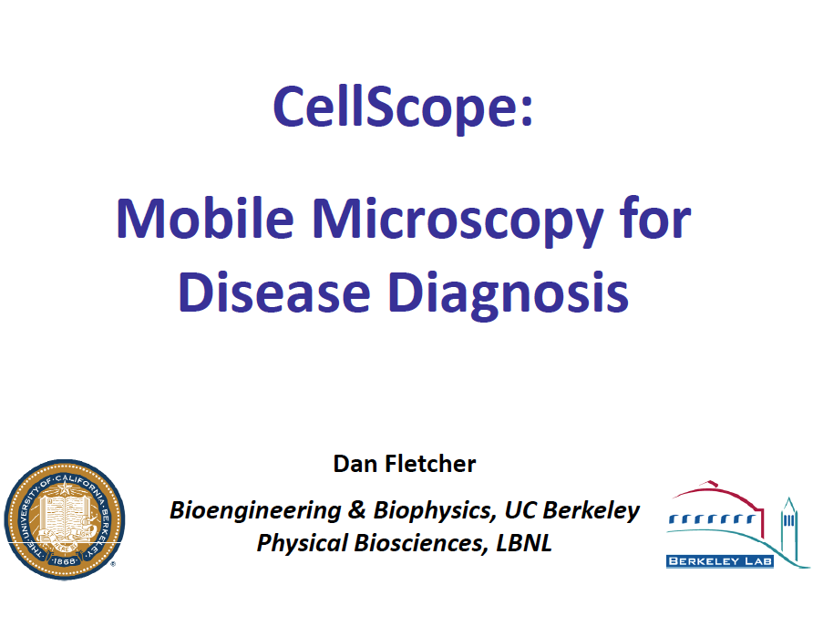

Slide 7
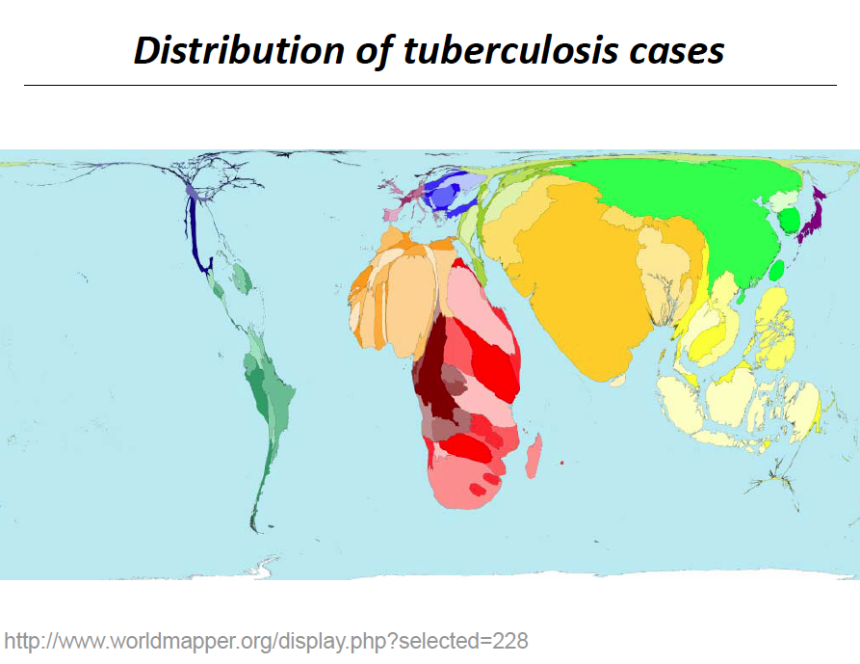

Slide 8
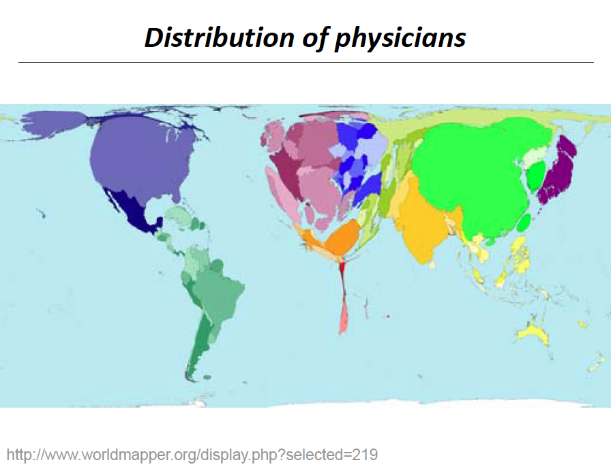

Slide 9
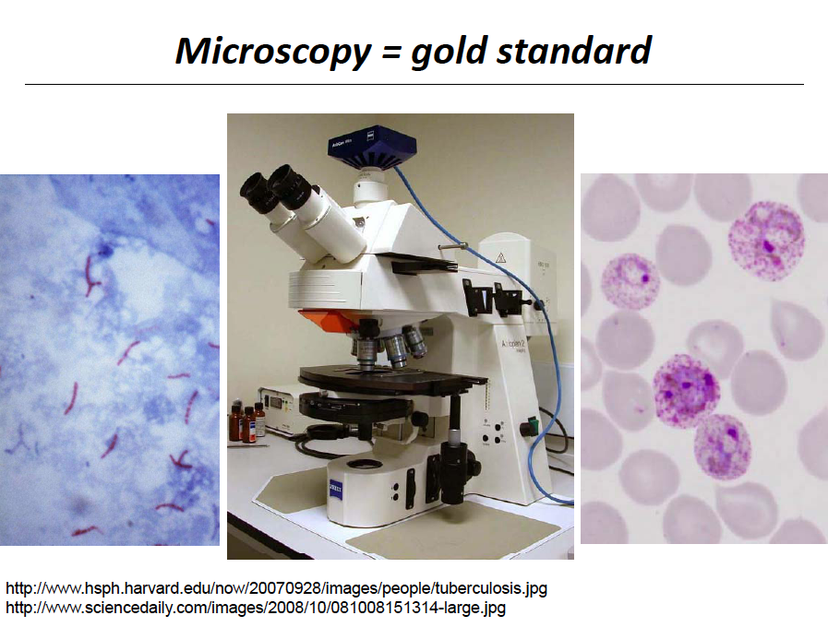

Slide 10
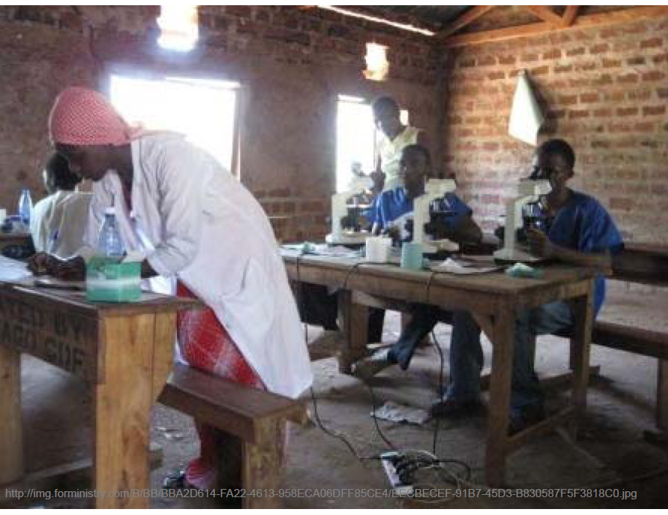

Slide 11
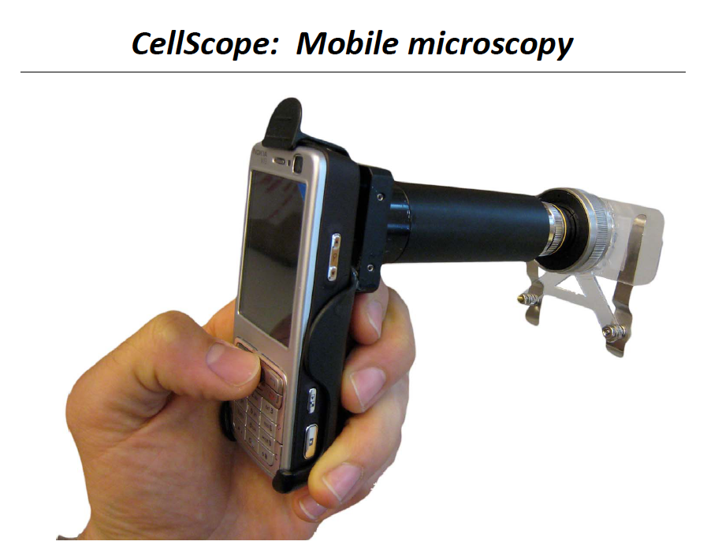

Slide 12
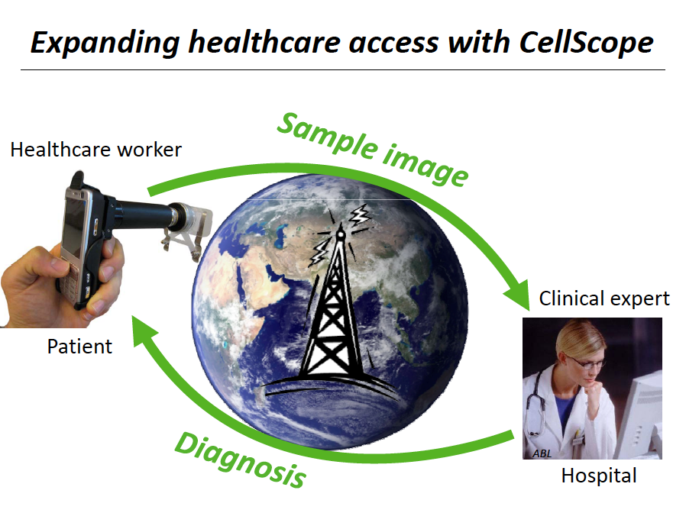

Slide 13
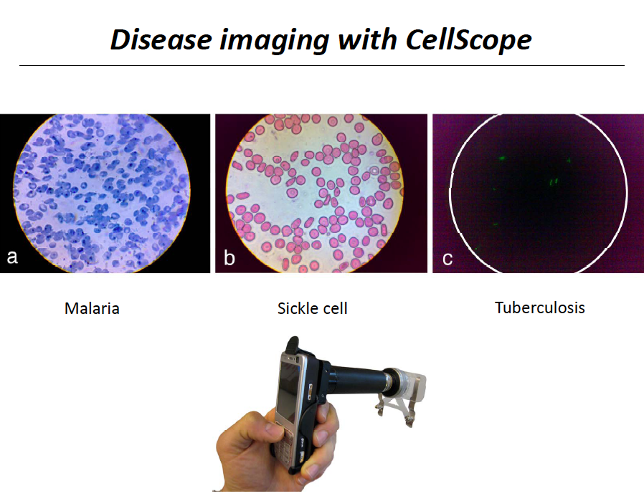

Slide 14
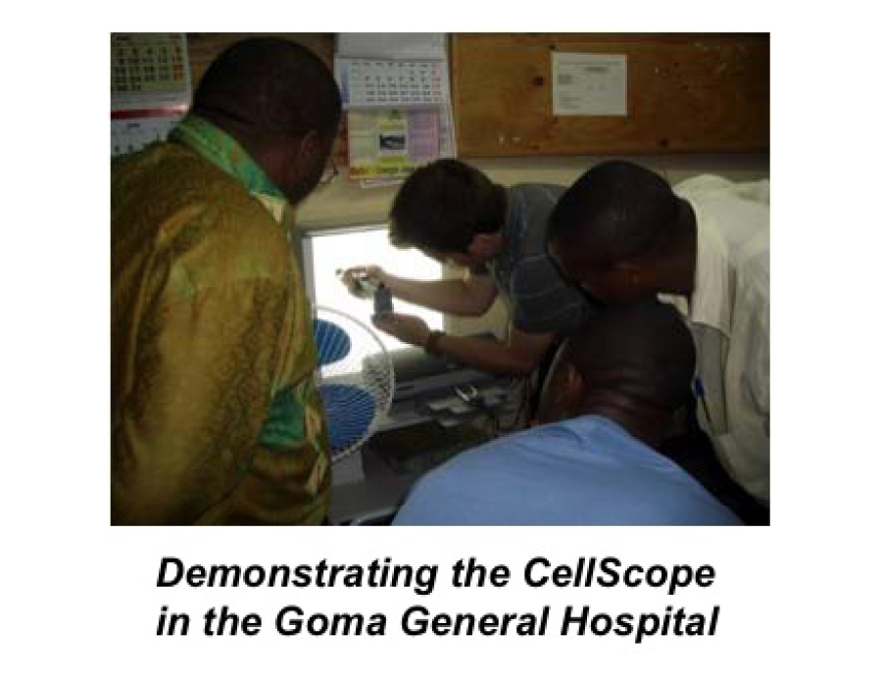

Slide 15
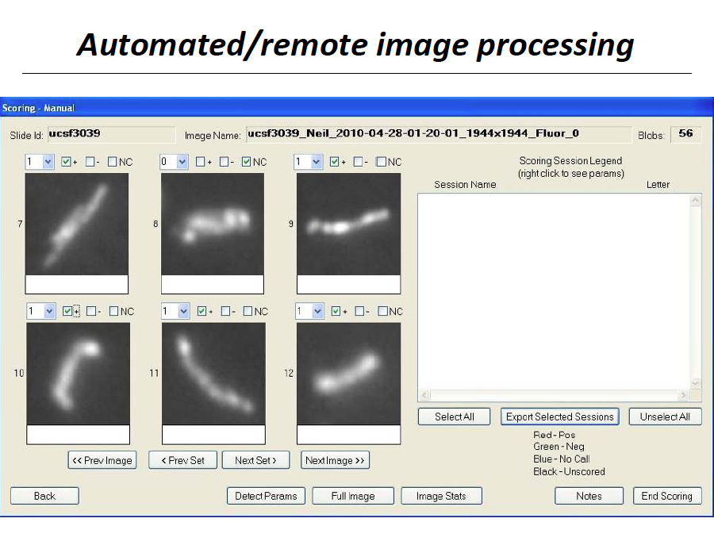

Slide 16
Discuss…

Slide 17
Discussion questions
What are the ethical considerations of automated medical diagnosis?
What level of accuracy is acceptable?
Would it be feasible to use this technology in a low resource setting?
What challenges would arise during a sustainable deployment of this technology?
What about training? Who would use it?

Slide 18
Non-contact, automated cardiac pulse measurements
Ming-Zher Poh, Daniel J. McDuff, and Rosalind W. Picard (MIT)

Slide 19
Manual measurement
Checking a person’s vital signs — pulse, respiration and blood pressure — can be done manually or by attaching sensors to the body.

Slide 20
Main idea
Develop a system that can measure these health indicators (pulse, respiration and blood pressure) automatically.
Use a low-cost camera (such as a built-in webcam).
http://www.youtube.com/watch?v=pjUS-e_SeLk&feature=related

Slide 21
So far…
The system can extract accurate pulse measurements from low-resolution webcam imagery.
Measures slight variations in brightness produced by the flow of blood through blood vessels in the face.

Slide 22
So far…
Produces pulse rates accurate to within about three beats per minute compared to approved manual monitoring devices.
Works even when the subject is moving a bit in front of the camera.
Can also get accurate pulse signals from three people in the camera’s view at the same time.

Slide 23
Next steps…
Extend the capabilities to measure respiration and blood-oxygen levels.
Eventually be able to monitor blood pressure as well.

Slide 24
Discuss…

Slide 25
Discuss…
In what situations would such a device be useful? Or dangerous?
What new challenges would arise when using this technology in a low resource setting?
What are the costs/benefits of this technology?
What are the implications of self-diagnosis by patients?

Slide 26
Automated spectroscopy in the classroom
Alexander Scheeline
(University of Illinois)

Slide 27
Main idea
Develop software that turns a camera phone, an LED, and a few other cheap tools into a spectrometer.

Slide 28
Applications
One of the most widely used means for identifying and quantifying materials in both physical and biological sciences.
By measuring the electromagnetic spectrum a substance absorbs or emits, you can determine its molecular composition.
Measure the amount of protein in meat, or water in grain, or iron in blood, etc.

Slide 29
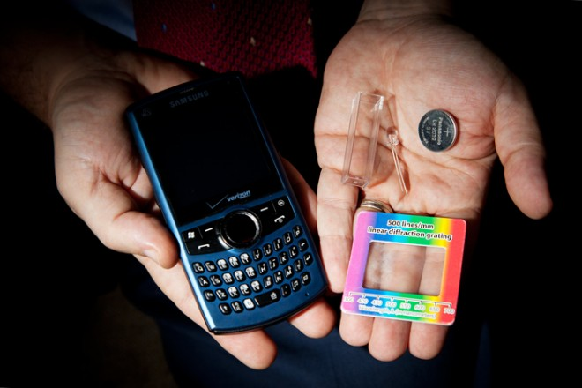
Set-up
Equipment (excluding camera) costs < $3

Slide 30
Education
“The potential is here to make analytical chemistry a subject for the masses rather than something that is only done by specialists.”
“There’s no doubt that getting the cost of equipment down to the point where more people can afford them in the education system is a boon for everybody.”
- Scheeline

Slide 31
Discuss…

Slide 32
Discuss…
How could this technology be applied to problems in ICTD?
Who would use an instrument like this?
What is likely to affect accuracy? How will accuracy affect potential applications?

